Slide 1
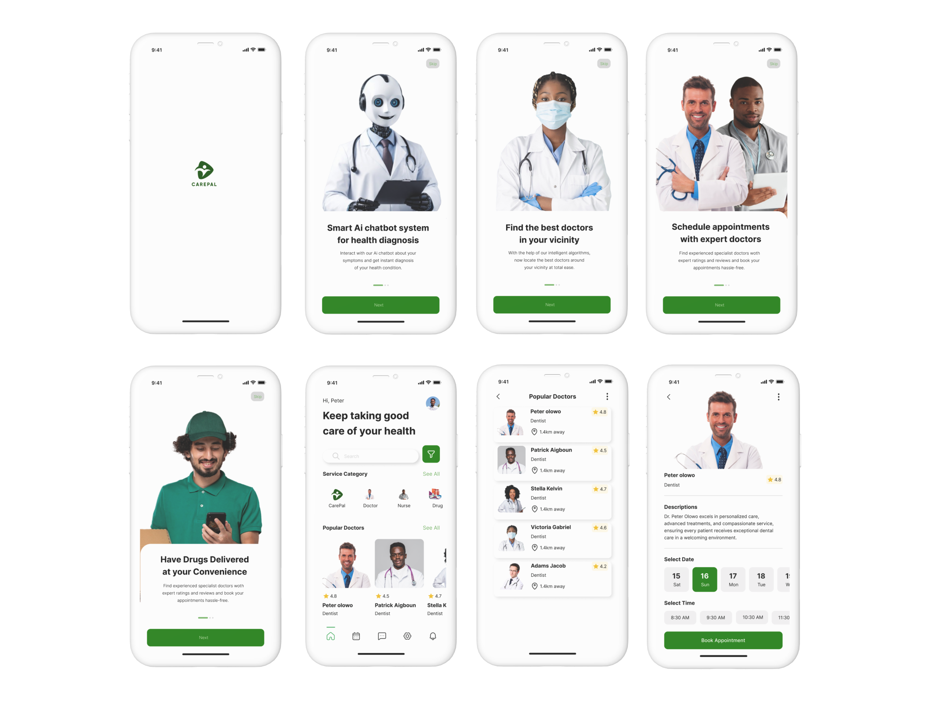

CarePal.
Ai-powered healthhub
Presented to you by
Tech Xplorers
Peter Olowo, Patrick Aigbogun, Adewuyi Adegoke, Adewunmi Yetunde

Slide 2


Why CarePal?
Observe these statistics
About 672 million Africans, representing 48 per cent of the continent's population, still lack access to the quality health care they need
estimated number of human who owns a smart phone in 2024 - 7.07 billion
There are over 5.3 billion mobile internet users globally.
92.3% of internet users consider accessing the internet through their smartphones..

Slide 3
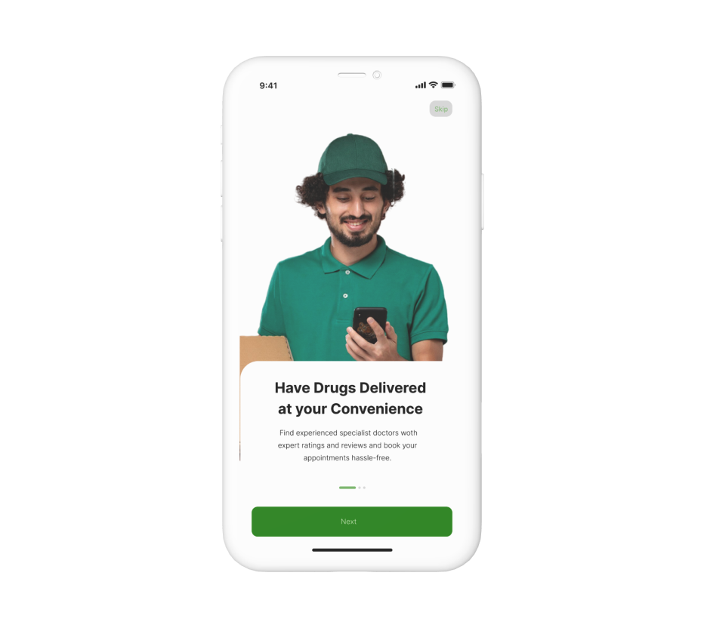
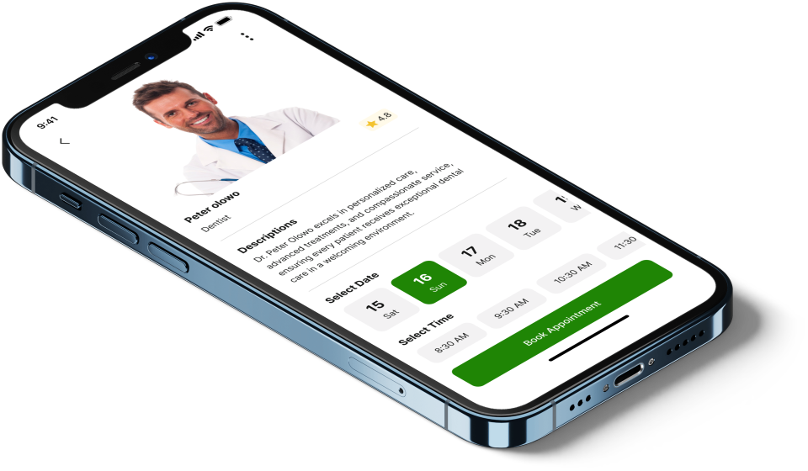
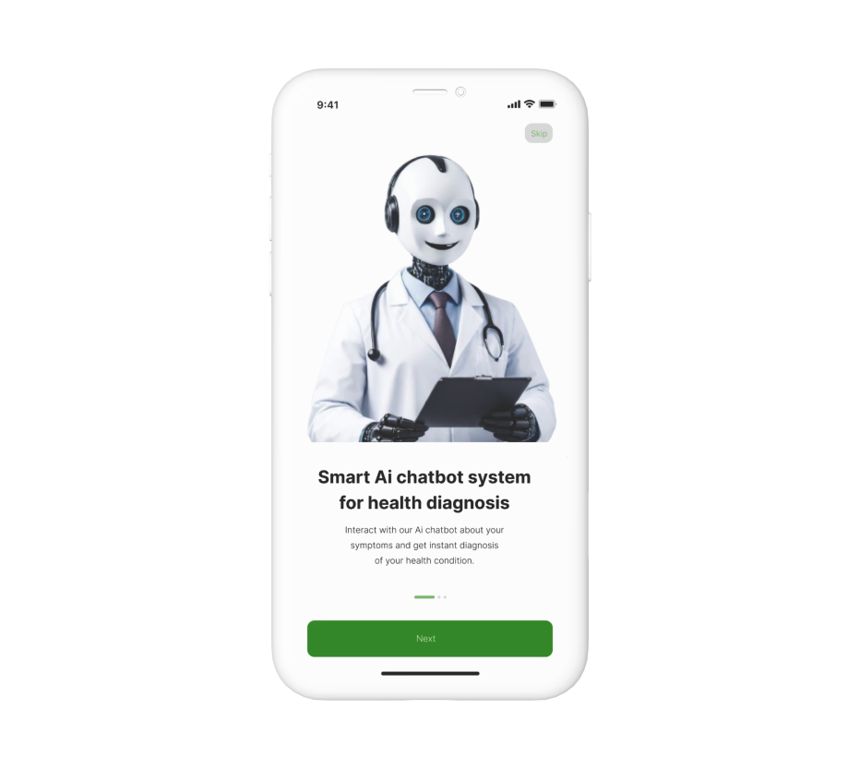
Features
Instant diagnosis
Recommendation to medical specialists/centres nearby
Drug delivery
Instant bookings/scheduling of appointment
Immediate consultation by
All in one medical hub

Slide 4
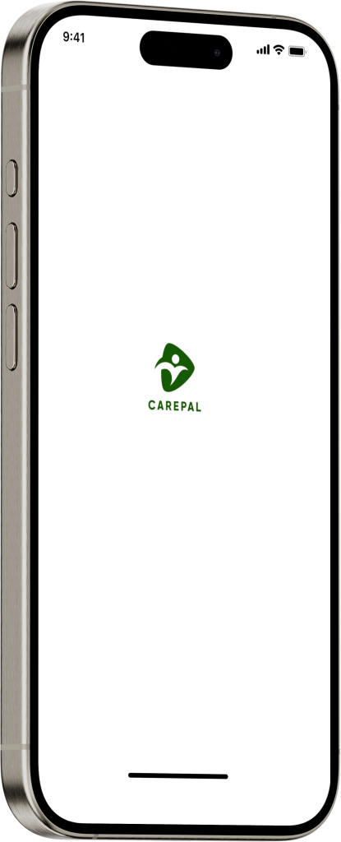
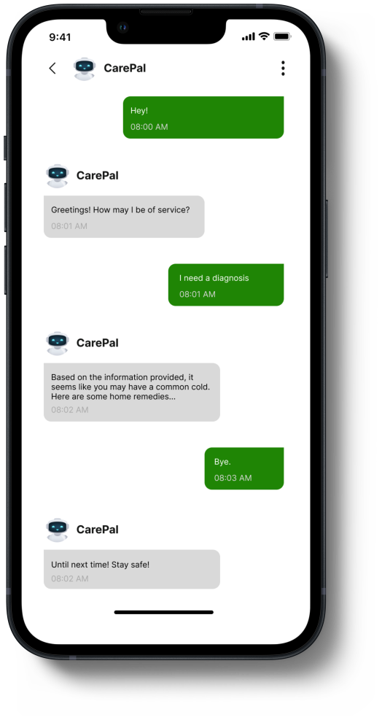
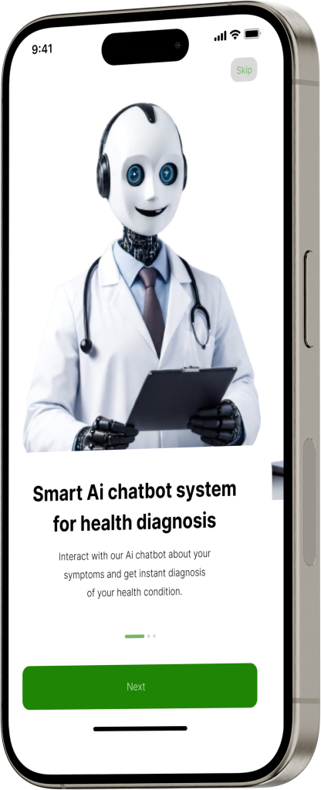

Slide 5
Profitability
Service transactions in-app
B2b operations
Targeted Userdata

